Slide 1


BVRIT HYDERABAD
College of Engineering for Women
Department of Information Technology
Title: GAMING APPLICATION ON ALZHEIMER’S DISEASE DETECTION
Date: 01-04-2023
Team - 7
K.Sanjana Reddy (19WH1A1219)
M.Deepthi Sharvani (19WH1A1220)
R.Rajani (19WH1A1241)
K.Aarthi (19WH1A1258)
Internal Guide:
Dr. Aruna Rao S.L
Professor & HoD
Department of Information Technology

Slide 2
AGENDA
Summary of Stage I
Implementation
Modules
Functionality of the Project
Conclusion
Department of Information Technology

Slide 3
SUMMARY OF STAGE 1
Registration process is completed
Implemented one game
Department of Information Technology

Slide 4
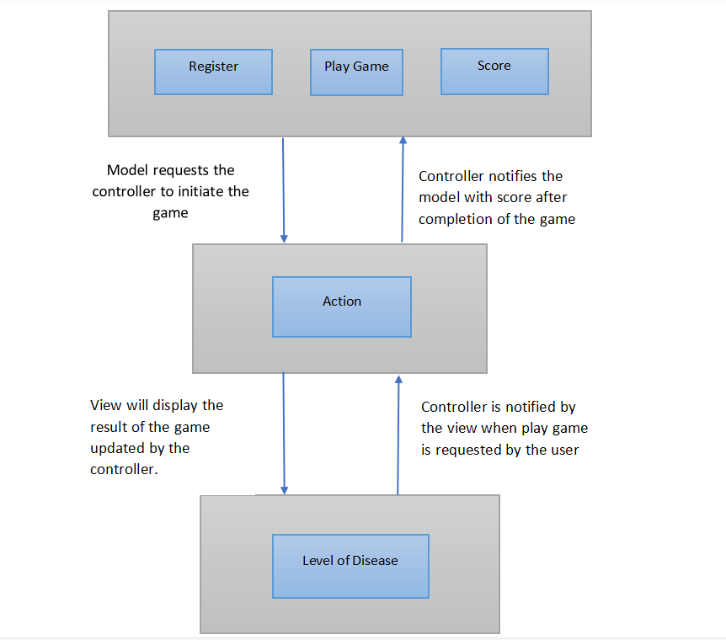
ARCHITECTURE
Department of Information Technology

Slide 5
MODULES
Module 1 | Registration | completed
Module 2 | Game Design | Three games implemeted and one game is integrated
Module 3 | Analyze the level of disease | Done with the survey
Department of Information Technology

Slide 6
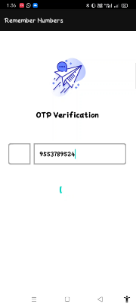
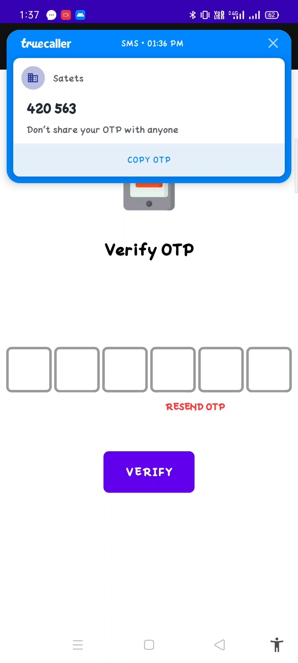
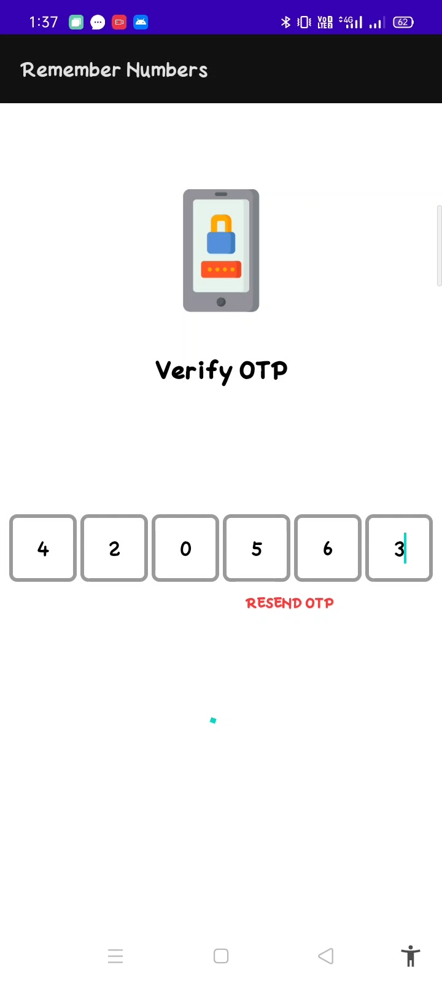
MODULE 1 IMPLEMENTATION
1. Registration
Department of Information Technology

Slide 7
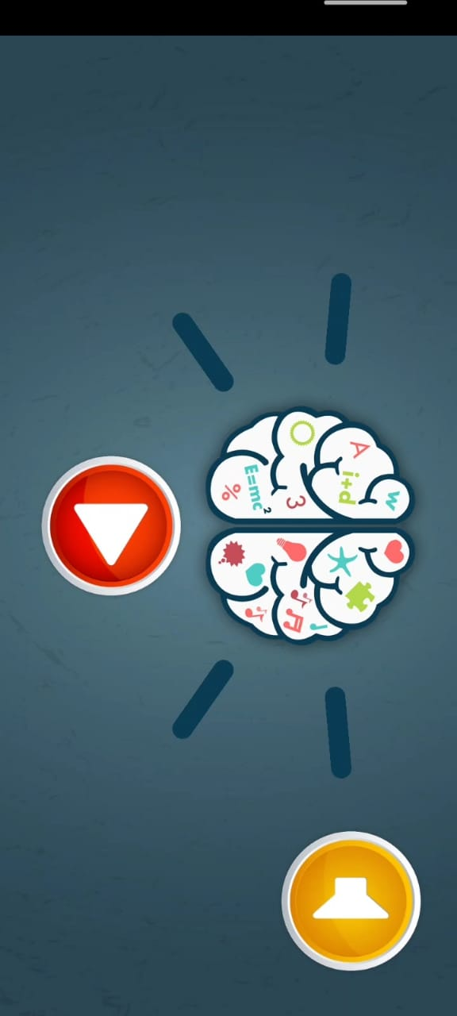
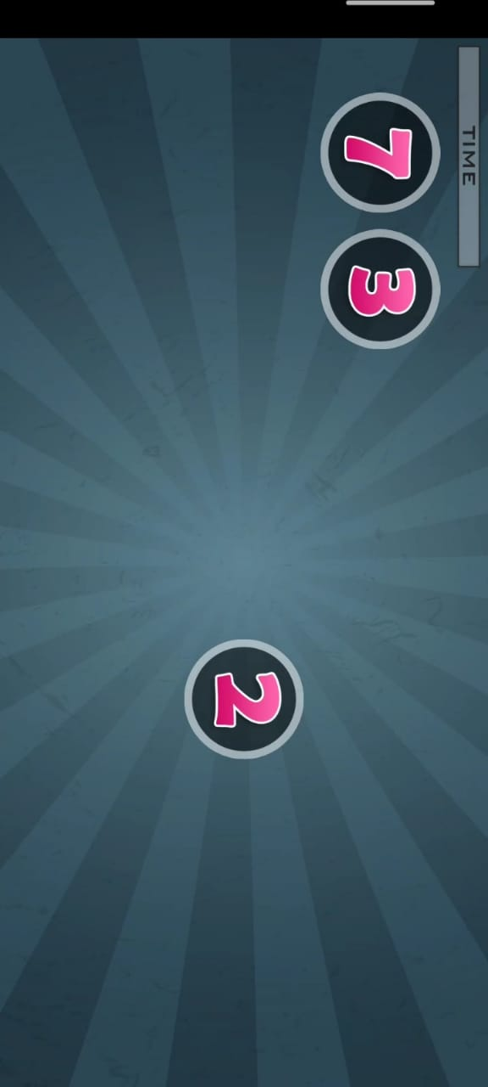
MODULE 2 IMPLEMENTATION(PARTIAL)
2.Number sort
Department of Information Technology

Slide 8
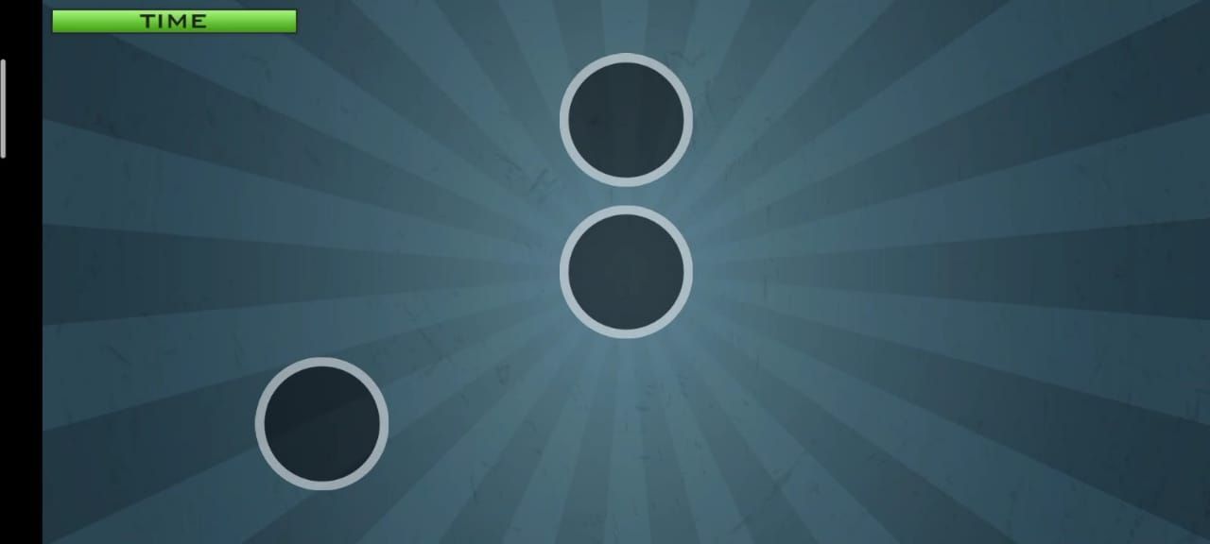
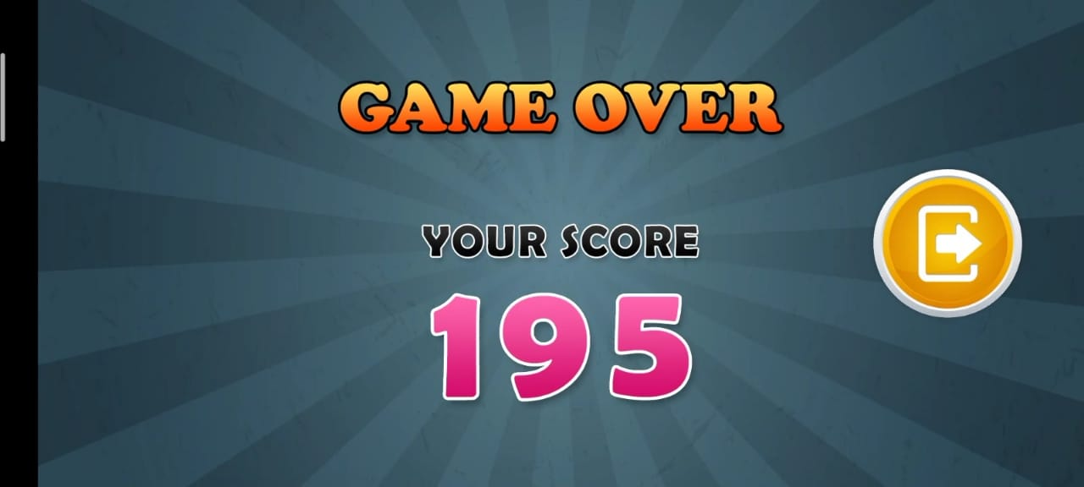
MODULE 2 IMPLEMENTATION(PARTIAL)
2.Number sort
Department of Information Technology

Slide 9
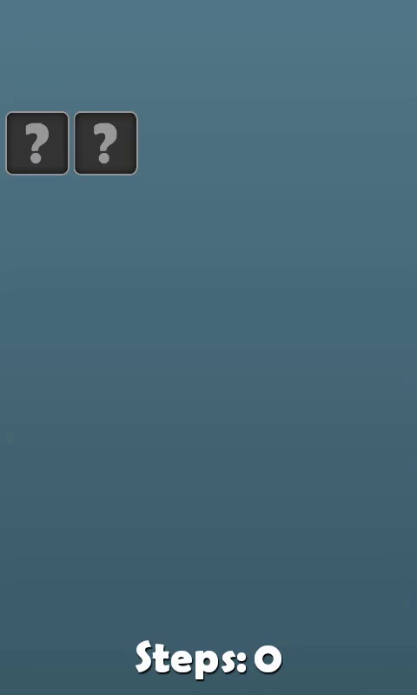
MODULE 2 IMPLEMENTATION(PARTIAL)
3. Matching game
Department of Information Technology

Slide 10
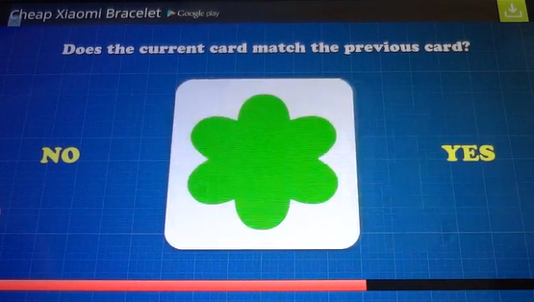
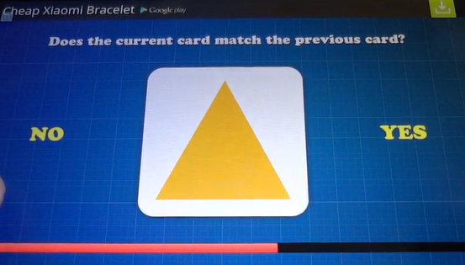
MODULE 2 IMPLEMENTATION(PARTIAL)
2.Does Card Match?
Department of Information Technology

Slide 11
MODULE 3 IMPLEMENTATION
Game | Age | Number of people | Score Range | observation
Numbe Sort | 45 - 60 | 12 | 200 - 450 | A normal person is able to remember the numbers at max till 8 circles.
Matching game | 45 - 60 | 12 | 130 - 250 | For a normal people initially when all the cards are unmatched, it takes more moves but when the number of cards keep reducing, we can complete with least moves
Card match | 45 - 60 | 12 | 150 - 300 | 1 - 2 seconds per tap
Department of Information Technology

Slide 12
CONCLUSION
Done with the Implemtation of registration and three games
One game integration and analysis of disease is completed
Integration of other two games is pending
Department of Information Technology

Slide 13
THANK YOU
Department of Information Technology

